Slide 1
Sorting Algorithms
Md. Tohidul Islam
Department of Computer Science and Engineering
University of Rajshahi

Slide 2
Sorting
Rearranging the values in an array or collection into a specific order (usually into their "natural ordering").
one of the fundamental problems in computer science
can be solved in many ways:
there are many sorting algorithms
some are faster/slower than others
some use more/less memory than others
some work better with specific kinds of data
some can utilize multiple computers / processors, ...

Slide 3
Sorting algorithms
bogo sort: shuffle and pray
bubble sort: swap adjacent pairs that are out of order
selection sort: look for the smallest element, move to front
insertion sort: build an increasingly large sorted front portion
merge sort: recursively divide the array in half and sort it
heap sort: place the values into a sorted tree structure
quick sort: recursively partition array based on a middle value
other specialized sorting algorithms:
bucket sort: cluster elements into smaller groups, sort them
radix sort: sort integers by last digit, then 2nd to last, then ...
...

Slide 4
Sorting Algorithms
Bogo Sort

Slide 5
Bogo sort
bogo sort: Orders a list of values by repetitively shuffling them and checking if they are sorted.
name comes from the word "bogus"
The algorithm:
Scan the list, seeing if it is sorted. If so, stop.
Else, shuffle the values in the list and repeat.
This sorting algorithm (obviously) has terrible performance!

Slide 6
Bogo sort C Code
bool is_sorted(int *a, int n)
{
while ( --n >= 1 )
{
if ( a[n] < a[n-1] ) return false;
}
return true;
}
void shuffle(int *a, int n)
{
int i, t, r;
for(i=0; i < n; i++)
{
t = a[i];
r = rand() % n;
a[i] = a[r];
a[r] = t;
}
}
void bogosort(int *a, int n)
{
while ( !is_sorted(a, n) ) shuffle(a, n);
}

Slide 7
Sorting Algorithms
Bubble Sort

Slide 8










Bubble Sort
Consider an array (5 1 4 2 8). Goal: Sort it in ascending order
Idea: Repeatedly swap the adjacent elements if they are in wrong order
First Pass
Second Pass
Third Pass
No swaps in this pass,
hence done! ☺

Slide 9
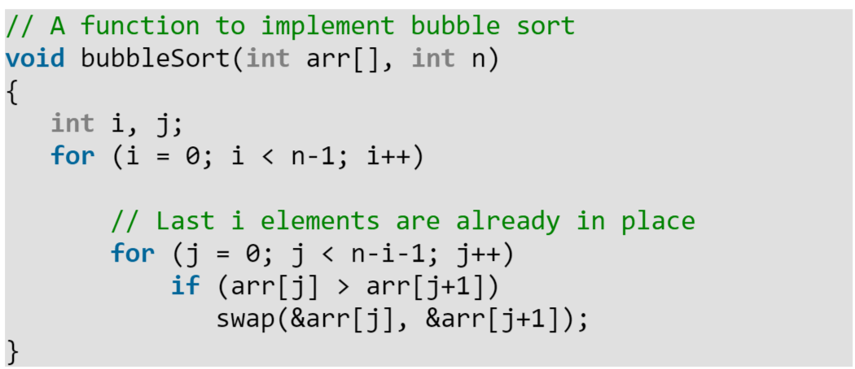
Bubble Sort

Slide 10
Sorting Algorithms
Selection Sort

Slide 11
Selection Sort
the list is divided into two parts, the sorted part at the left end and the unsorted part at the right end.
Initially, the sorted part is empty and the unsorted part is the entire list.
selects the smallest element from an unsorted list in each iteration and places that element at the beginning of the unsorted list.
This process continues moving unsorted array boundary by one element to the right.

Slide 12
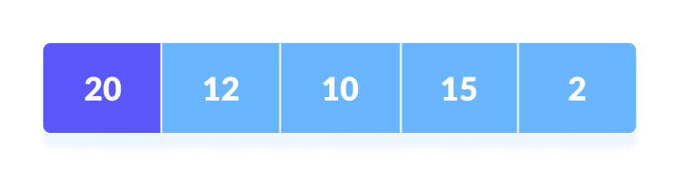
How Selection Sort Works?
Consider the following data to be sorted :
Set the first element as minimum.
Compare minimum with the second element. If the second element is smaller than minimum, assign the second element as minimum.
Compare minimum with the third element. Again, if the third element is smaller, then assign minimum to the third element otherwise do nothing.
The process goes on until the last element.

Slide 13
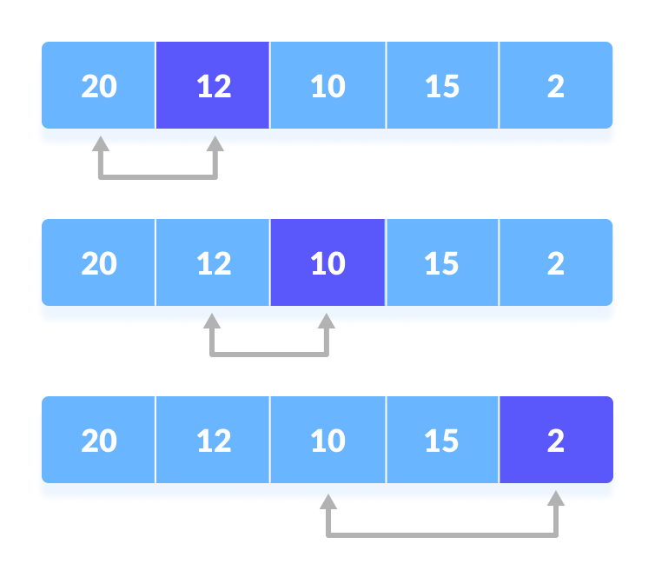
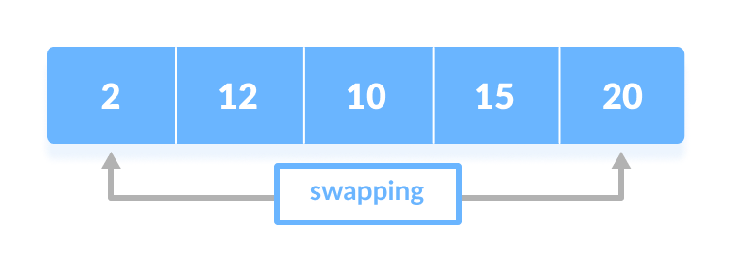
How Selection Sort Works?
After each iteration, minimum is placed in the front of the unsorted list.
For each iteration, indexing starts from the first unsorted element.
Above Steps are repeated until all the elements are placed at their correct positions.

Slide 14
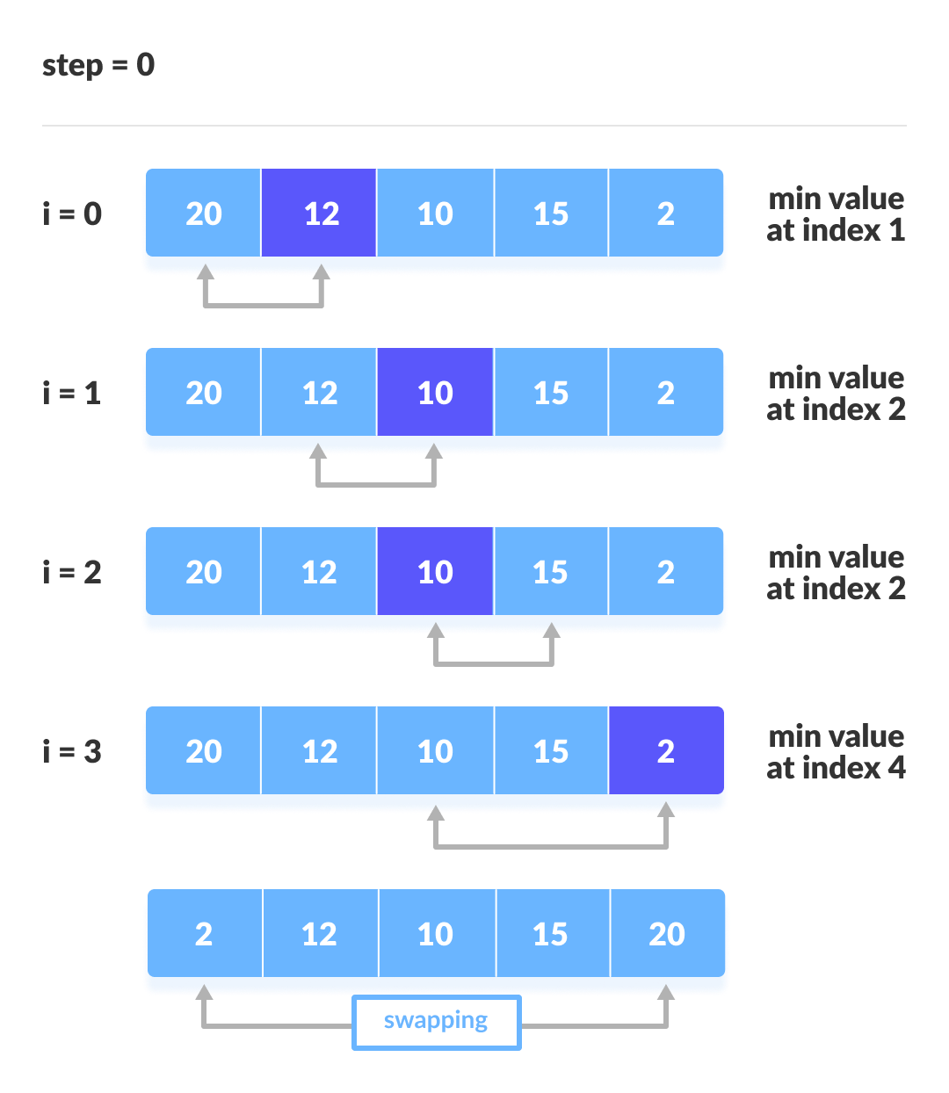
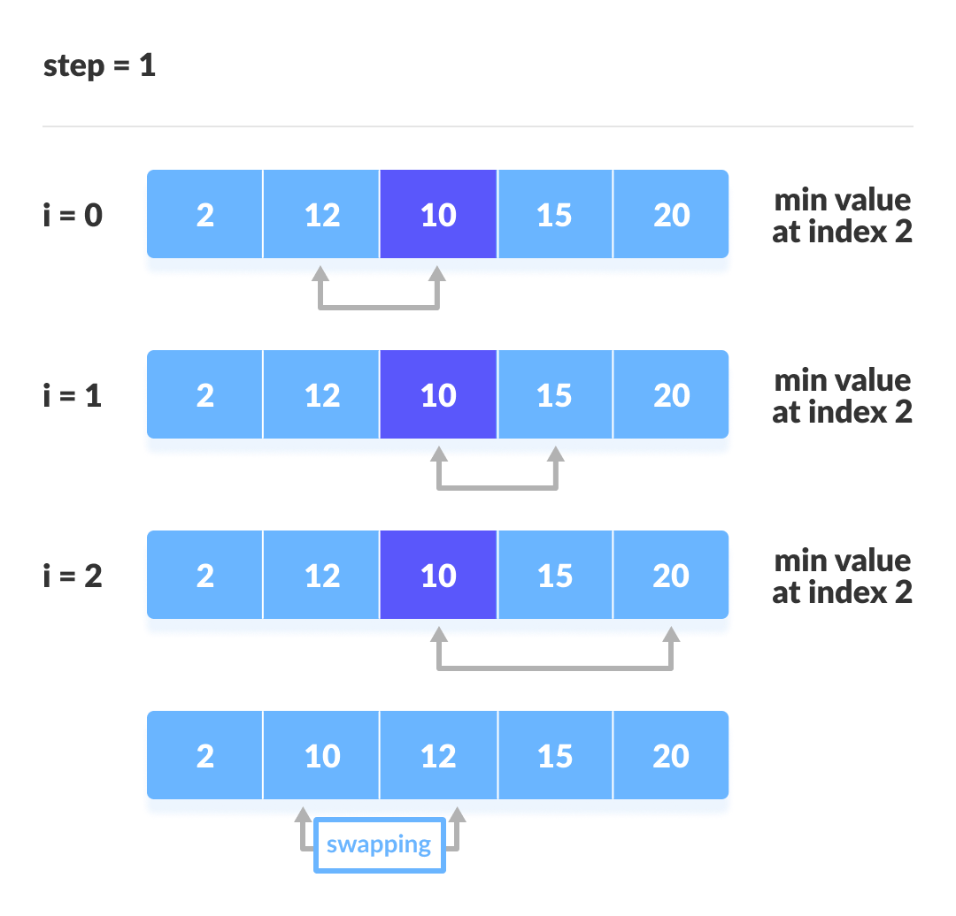
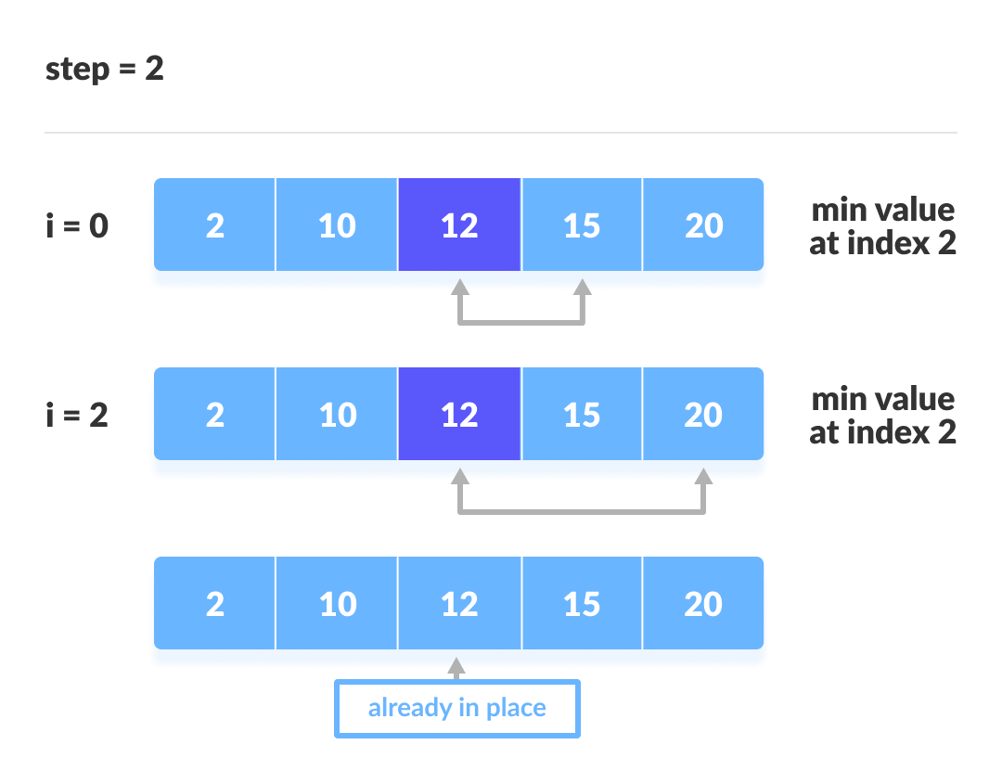
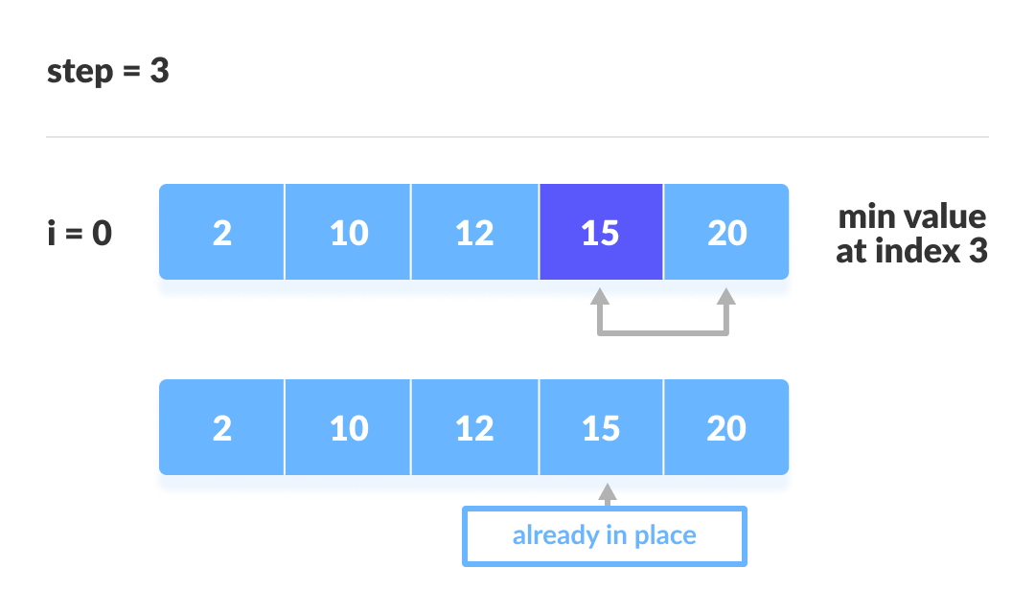
How Selection Sort Works?

Slide 15
Time Complexities: Selection Sort
Worst Case Complexity: O(n²)
Best Case Complexity: O(n²)
Average Case Complexity: O(n²)
Space Complexity:
Space complexity is O(1) because an extra variable temp is used.

Slide 16
Sorting Algorithms
Insertion Sort

Slide 17
Insertion Sort
The array is virtually split into a sorted and an unsorted part.
Values from the unsorted part are picked and placed at the correct position in the sorted part.
To sort an array of size N in ascending order iterate over the array and compare the current element (key) to its predecessor, if the key element is smaller than its predecessor, compare it to the elements before.
Move the greater elements one position up to make space for the swapped element.

Slide 18
Working of Insertion Sort
Consider an example: arr[]: {12, 11, 13, 5, 6}
First Pass:
Initially, the first two elements of the array are compared.
Here, 12 is greater than 11 hence swap 11 and 12.
So, for now 11 is stored in a sorted sub-array.
12 | 11 | 13 | 5 | 6
12 | 11 | 13 | 5 | 6
11 | 12 | 13 | 5 | 6

Slide 19
Working of Insertion Sort
Second Pass:
Now compare the next two elements of the array.
Here, 13 is greater than 12, hence, no swapping will occur. 12 also stored in a sorted sub-array along with 11.
Third Pass:
Now compare 13 and 5 of the array.
Both 5 and 13 are not present at their correct place so swap them
11 | 12 | 13 | 5 | 6
11 | 12 | 13 | 5 | 6
11 | 12 | 5 | 13 | 6

Slide 20
Working of Insertion Sort
After swapping, elements 12 and 5 are not sorted, thus swap again.
Here, again 11 and 5 are not sorted, hence swap again.
Here, 5 is at its correct position.
Fourth Pass:
The elements which are present in the sorted sub-array are 5, 11 and 12
Moving to the next two elements 13 and 6
Clearly, they are not sorted, thus perform swap between both
11 | 5 | 12 | 13 | 6
5 | 11 | 12 | 13 | 6
5 | 11 | 12 | 13 | 6
5 | 11 | 12 | 6 | 13

Slide 21
Working of Insertion Sort
We need two more swapping between 12 and 6; then between 11 and 6.
Finally, the array is completely sorted.
Time Complexity of Insertion Sort
The worst-case time complexity of the Insertion sort is O(n²)
The average case time complexity of the Insertion sort is O(n²)
The time complexity of the best case is O(n).
Space Complexity of Insertion Sort
The auxiliary space complexity of Insertion Sort is O(1)
5 | 11 | 6 | 12 | 13
5 | 6 | 11 | 12 | 13

Slide 22
Sorting Algorithms
Merge Sort

Slide 23
Merge sort
merge sort: Repeatedly divides the data in half, sorts each half, and combines the sorted halves into a sorted whole.
The algorithm:
Divide the list into two roughly equal halves.
Sort the left half.
Sort the right half.
Merge the two sorted halves into one sorted list.
Often implemented recursively.
An example of a "divide and conquer" algorithm.
Invented by John von Neumann in 1945

Slide 24
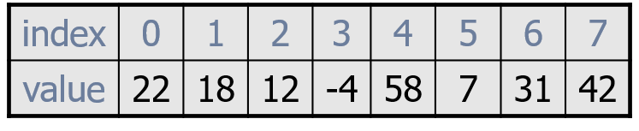





















Merge sort example
split
split
split
split
split
split
split
merge
merge
merge
merge
merge
merge
merge

Slide 25
Merge Sort
9
1
9
4
2
1
2
7
5
8
3
5
2
1
4
8
?
Merge Sort
?
Merge Sort
1
1
2
2
4
7
9
9
1
2
3
4
5
5
8
8
?
Merge
1
1
1
2
2
2
3
4
4
5
5
7
8
8
9
9
Trick: Merging two sorted arrays is very easy!

Slide 26
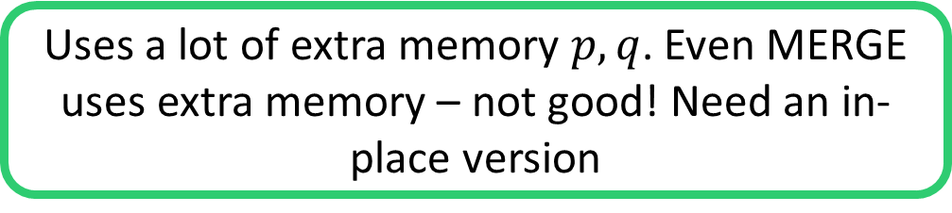
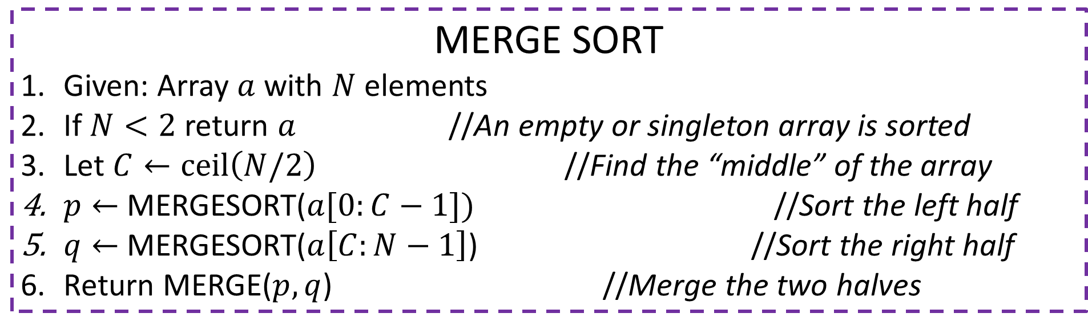
Merge Sort
MERGE SORT
Given: Array $a$ with $N$ elements
If $N<2$ return $a$ //An empty or singleton array is sorted
Let $C←ceil\left(N/2\right)$ //Find the “middle” of the array
$p←$ MERGESORT($a[0:C−1])$ //Sort the left half
$q←$ MERGESORT($a\left[C:N−1\right]$) //Sort the right half
Return MERGE($p,q$) //Merge the two halves
A sort algorithm is called in-place if it does not use extra memory e.g. extra arrays, to sort the given array
Uses a lot of extra memory $p,q$. Even MERGE uses extra memory – not good! Need an in-place version

Slide 27
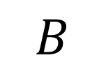
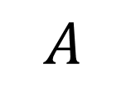
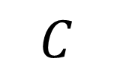
The Merge Operation
1
1
2
2
4
7
9
9
1
2
3
4
5
5
8
8
$$A$$
$$B$$
Merge
1
1
1
2
2
2
3
4
4
5
5
7
8
8
9
9
$$C$$
9 is larger: A wins
9 is larger: A wins again
8 is larger: B wins
8 is larger: B wins again

Slide 28
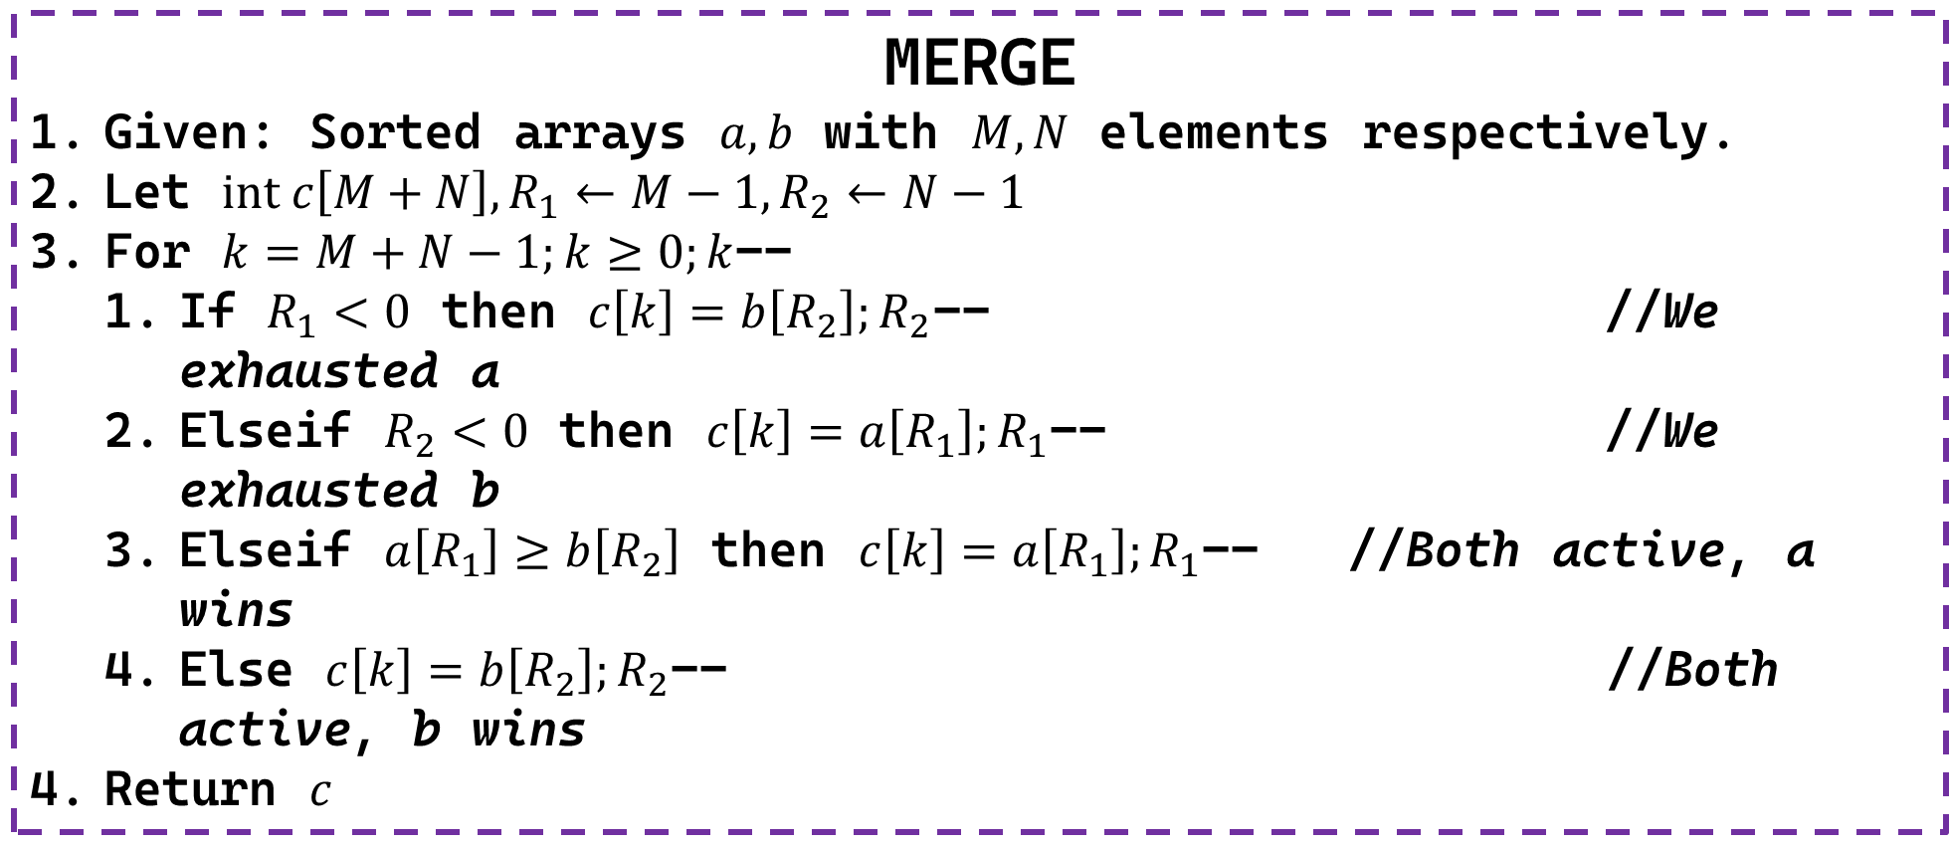
The Merge Operation
MERGE
Given: Sorted arrays $a,b$ with $M,N$ elements respectively.
Let $int c\left[M+N\right], R_{1}←M−1,R_{2}←N−1$
For $k=M+N−1;k≥0;k$--
If $R_{1}<0$ then $c\left[k\right]=b\left[R_{2}\right];R_{2}$-- //We exhausted a
Elseif $R_{2}<0$ then $c\left[k\right]=a\left[R_{1}\right];R_{1}$-- //We exhausted b
Elseif $a\left[R_{1}\right]≥b\left[R_{2}\right]$ then $c\left[k\right]=a\left[R_{1}\right];R_{1}$-- //Both active, a wins
Else $c\left[k\right]=b\left[R_{2}\right];R_{2}$-- //Both active, b wins
Return $c$

Slide 29
Sorting Algorithms
Quick Sort

Slide 30
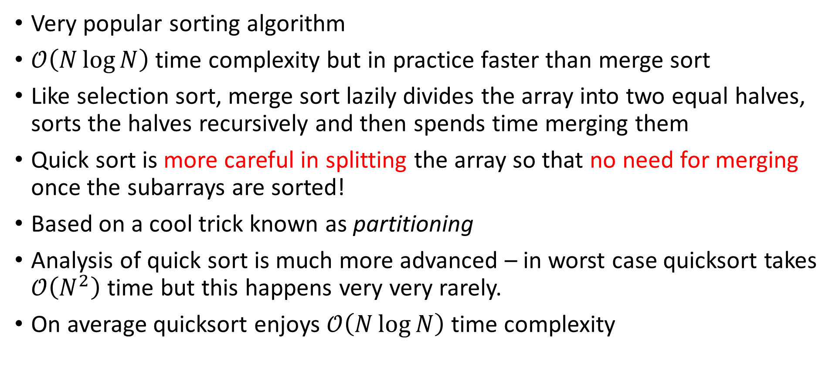
Quick Sort
Very popular sorting algorithm
$𝒪\left(N\log{N}\right)$ time complexity but in practice faster than merge sort
Like selection sort, merge sort lazily divides the array into two equal halves, sorts the halves recursively and then spends time merging them
Quick sort is more careful in splitting the array so that no need for merging once the subarrays are sorted!
Based on a cool trick known as partitioning
Analysis of quick sort is much more advanced – in worst case quicksort takes $𝒪\left(N^{2}\right)$ time but this happens very very rarely.
On average quicksort enjoys $𝒪\left(N\log{N}\right)$ time complexity

Slide 31

The Partition Technique
Given array $int a\left[N\right]$ and any element of the array $p$ (called pivot)
Create a new array $int b\left[N\right]$ which is arranged as follows $\left[elements of a≤p, p, elements of a≥p\right]$
Notice that left and right halves are not sorted yet! 😐
Also, the two halves are not balanced (of same size) either 😐
9
1
9
4
2
1
2
7
5
8
3
5
2
1
4
8
1
2
1
2
2
1
3
8
4
5
8
5
7
4
9
9

Slide 32
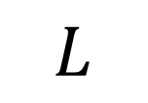
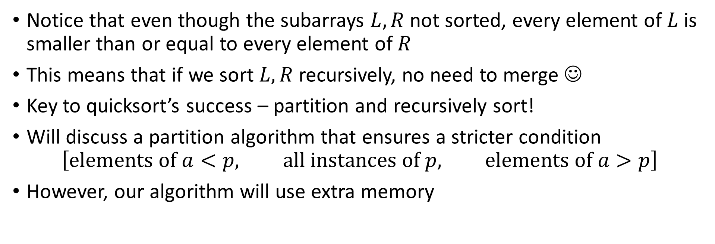
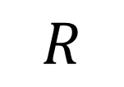
Quick Sort
1
2
1
2
2
1
3
8
4
5
8
5
7
4
9
9
$$L$$
$$R$$
Notice that even though the subarrays $L,R$ not sorted, every element of $L$ is smaller than or equal to every element of $R$
This means that if we sort $L,R$ recursively, no need to merge ☺
Key to quicksort’s success – partition and recursively sort!
Will discuss a partition algorithm that ensures a stricter condition $\left[elements of a<p, all instances of p, elements of a>p\right]$
However, our algorithm will use extra memory

Slide 33
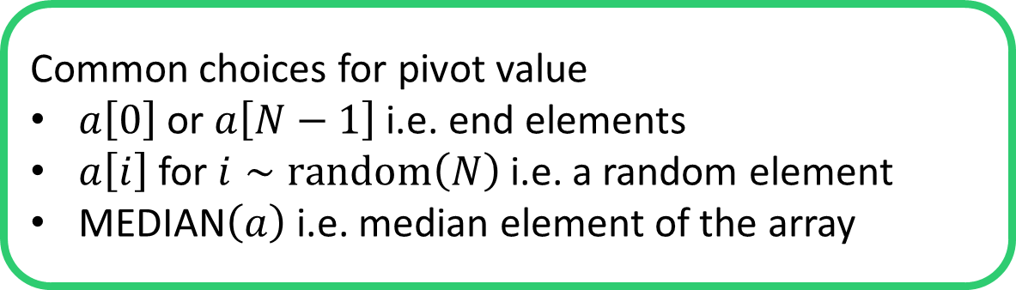
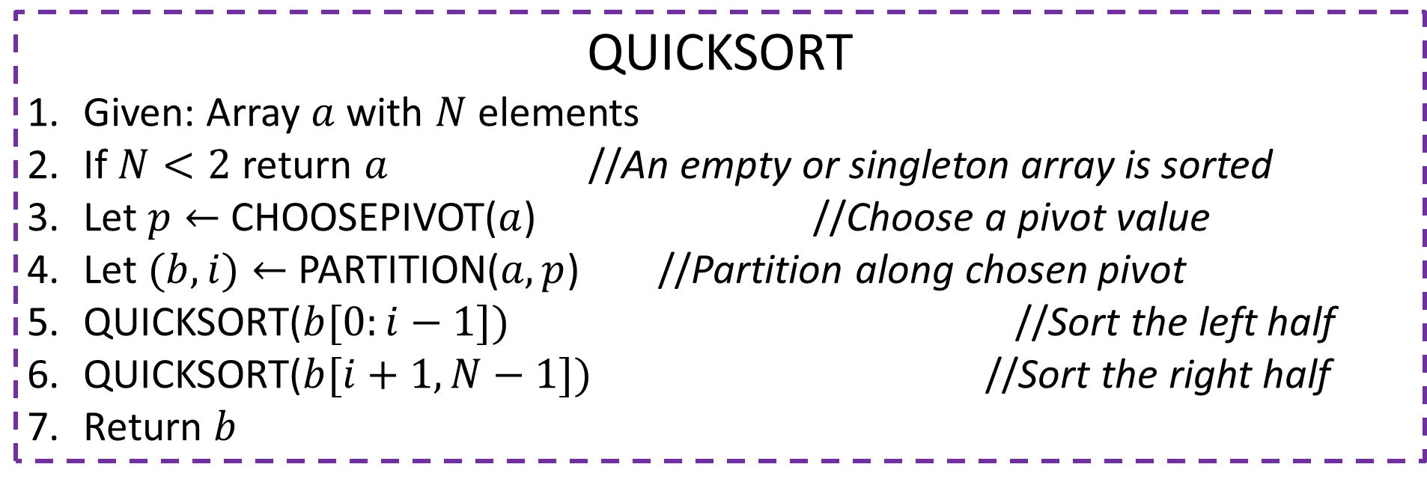

Quick Sort
QUICKSORT
Given: Array $a$ with $N$ elements
If $N<2$ return $a$ //An empty or singleton array is sorted
Let $p←$ CHOOSEPIVOT($a$) //Choose a pivot value
Let $(b,i)←$ PARTITION($a,p$) //Partition along chosen pivot
QUICKSORT($b[0:i−1])$ //Sort the left half
QUICKSORT($b[i+1,N−1])$ //Sort the right half
Return $b$
$i$ is the new location of the pivot element
Most popular, inexpensive
Also common, inexpensive
Common choices for pivot value
$a\left[0\right]$ or $a\left[N−1\right]$ i.e. end elements
$a\left[i\right]$ for $i∼random\left(N\right)$ i.e. a random element
MEDIAN$\left(a\right)$ i.e. median element of the array
Ensures balanced partition but expensive

Slide 34
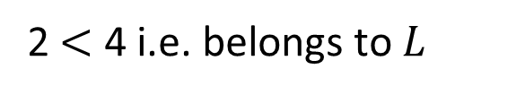
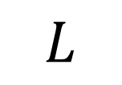
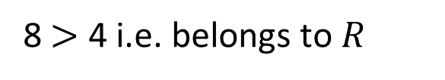
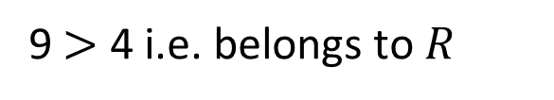
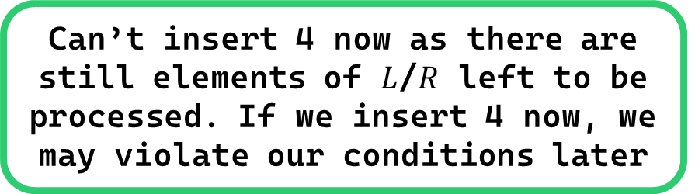
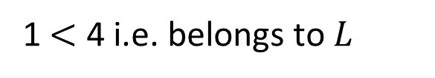
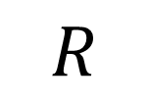
The Partition Procedure
We are sure now that any blank spaces left must be occurrences of pivot 4 that we omitted earlier
We will insert all occurrences of the pivot element 4 after we are done with non-pivot elements
PIVOT =
4
9
1
9
4
2
1
2
7
5
8
3
5
2
1
4
8
1
2
1
2
3
2
1
4
4
8
5
8
5
7
9
9
$$L$$
$$R$$
Can’t insert 4 now as there are still elements of $L$/$R$ left to be processed. If we insert 4 now, we may violate our conditions later
9 $>$ 4 i.e. belongs to $R$
1 $<$ 4 i.e. belongs to $L$
9 $>$ 4 i.e. belongs to $R$
8 $>$ 4 i.e. belongs to $R$
2 $<$ 4 i.e. belongs to $L$

Slide 35

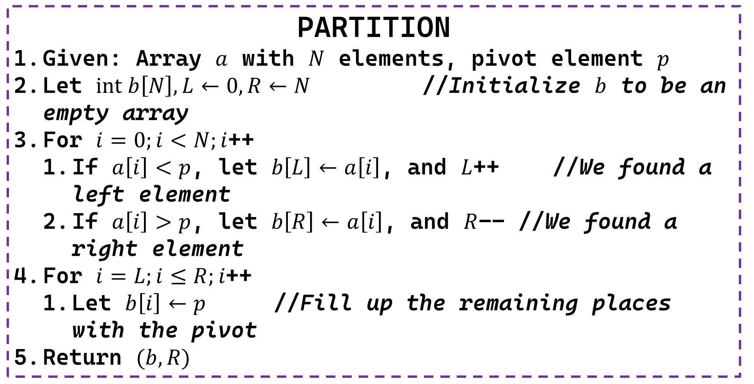


The Partition Procedure
PARTITION
Given: Array $a$ with $N$ elements, pivot element $p$
Let $int b\left[N\right], L←0,R←N$ //Initialize $b$ to be an empty array
For $i=0;i<N;i$++
If $a\left[i\right]<p$, let $b\left[L\right]←a\left[i\right]$, and $L$++ //We found a left element
If $a\left[i\right]>p$, let $b\left[R\right]←a\left[i\right]$, and $R$-- //We found a right element
For $i=L;i≤R;i$++
Let $b\left[i\right]←p$ //Fill up the remaining places with the pivot
Return $(b,R)$
Verify that after the first loop has ended, we must have $L<R$ i.e. some space left for pivot
In fact, the entire range $b\left[L:R\right]$ is filled with the pivot element
$R$ has to be (one of) the new location(s) of the pivot element

Slide 36

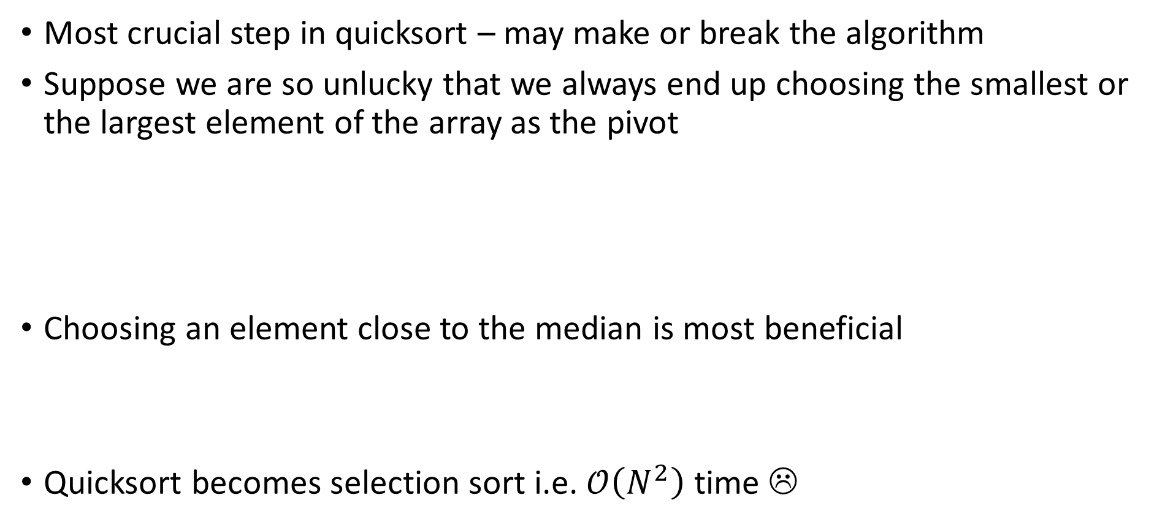
Choice of Pivot
Ironically, if the array is already sorted and we use end elements as pivots, then quicksort takes $𝒪\left(N^{2}\right)$ time ☹
Most crucial step in quicksort – may make or break the algorithm
Suppose we are so unlucky that we always end up choosing the smallest or the largest element of the array as the pivot
Choosing an element close to the median is most beneficial
Quicksort becomes selection sort i.e. $𝒪\left(N^{2}\right)$ time ☹
9
1
8
4
2
1
2
7
5
8
3
5
2
1
4
8
1
2
1
2
2
1
3
8
4
5
8
5
7
4
8
9

Slide 37
Sorting Algorithms
Counting Sort

Slide 38
Counting Sort
Sorts the elements of an array by counting the number of occurrences of each unique element in the array.
The count is stored in an auxiliary array and the sorting is done by mapping the count as an index of the auxiliary array.

Slide 39
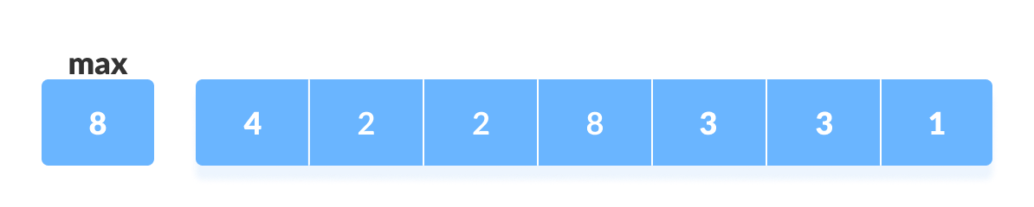
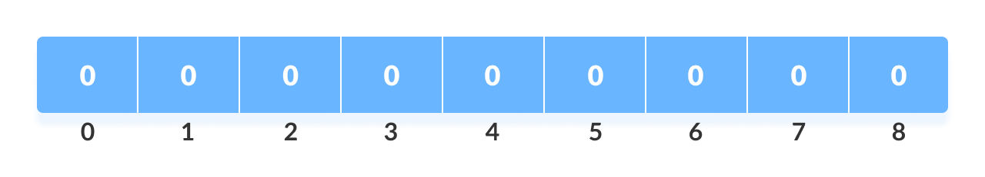
Working of Counting Sort
Find out the maximum element (let it be max) from the given array.
Initialize an array of length max+1 with all elements 0. This array is used for storing the count of the elements in the array.

Slide 40
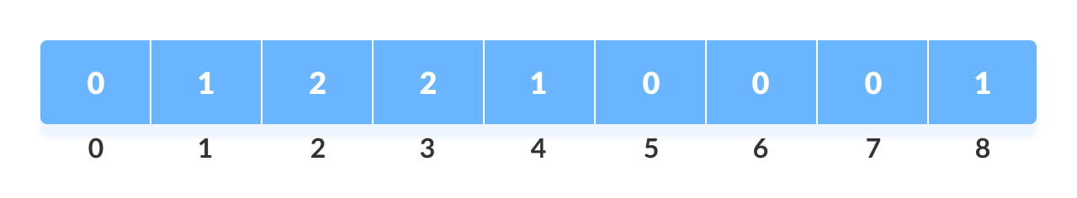
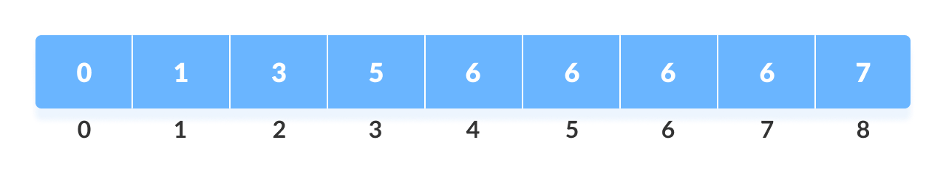
Working of Counting Sort
Store the count of each element at their respective index in count array.
For example: if the count of element 3 is 2 then, 2 is stored in the 3rd position of count array. If element "5" is not present in the array, then 0 is stored in 5th position.
Store cumulative sum of the elements of the count array. It helps in placing the elements into the correct index of the sorted array.

Slide 41
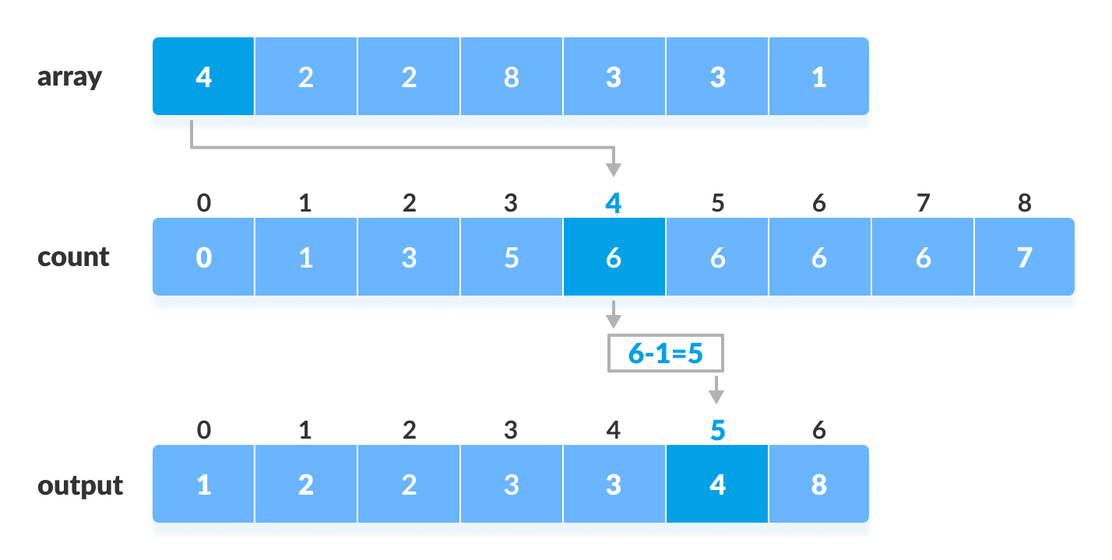
Working of Counting Sort
Find the index of each element of the original array in the count array. This gives the cumulative count. Place the element at the index calculated as shown in figure below.
After placing each element at its correct position, decrease its count by one.

Slide 42
Complexity of Counting Sort
Time Complexity
Best O(n+k)
Worst O(n+k)
Average O(n+k)
Space Complexity O(max)

Slide 43
Sorting Algorithms
Radix Sort

Slide 44
Radix Sort
Sorts the elements by first grouping the individual digits of the same place value. Then, sort the elements according to their increasing/decreasing order.
Suppose, we have an array of 8 elements.
First, we will sort elements based on the value of the unit place.
Then, we will sort elements based on the value of the tenth place.
This process goes on until the last significant place.

Slide 45
How does Radix Sort Algorithm work?
To perform radix sort on the array [170, 45, 75, 90, 802, 24, 2, 66], we follow these steps:
Step 1: Find the largest element in the array, which is 802. It has three digits, so we will iterate three times, once for each significant place.
Step 2: Sort the elements based on the unit place digits (X=0).
Sorting based on the unit place:
Perform counting sort on the array based on the unit place digits.
The sorted array based on the unit place is [170, 90, 802, 2, 24, 45, 75, 66].

Slide 46
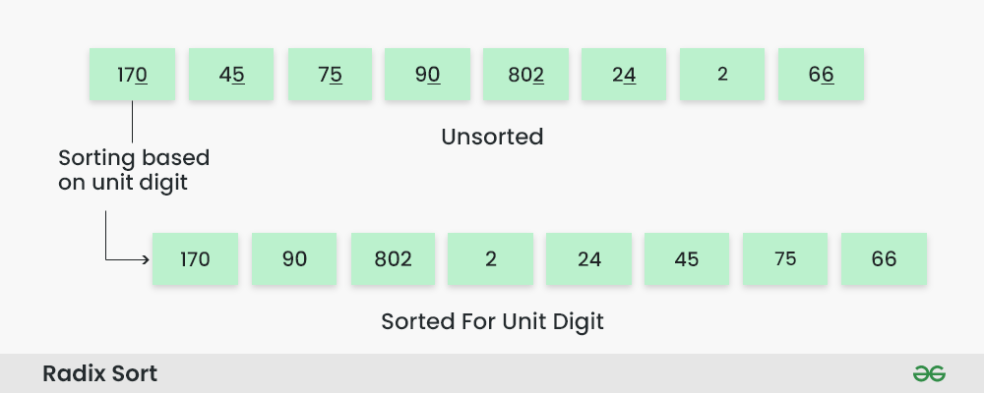
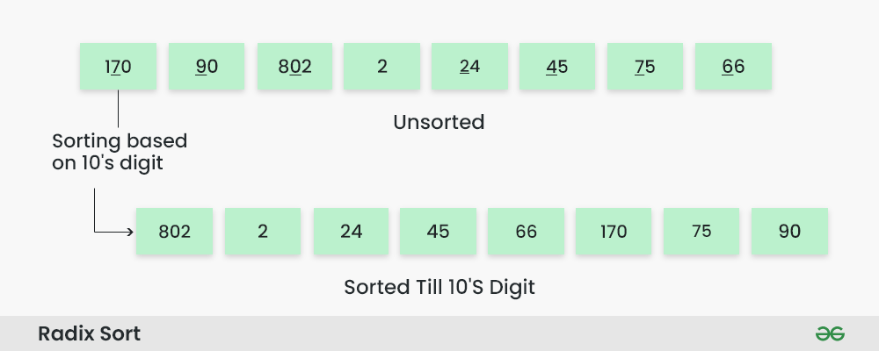
How does Radix Sort Algorithm work?
Step 3: Sorting based on the tens place:
Perform counting sort on the array based on the tens place digits.
The sorted array based on the tens place is [802, 2, 24, 45, 66, 170, 75, 90].

Slide 47
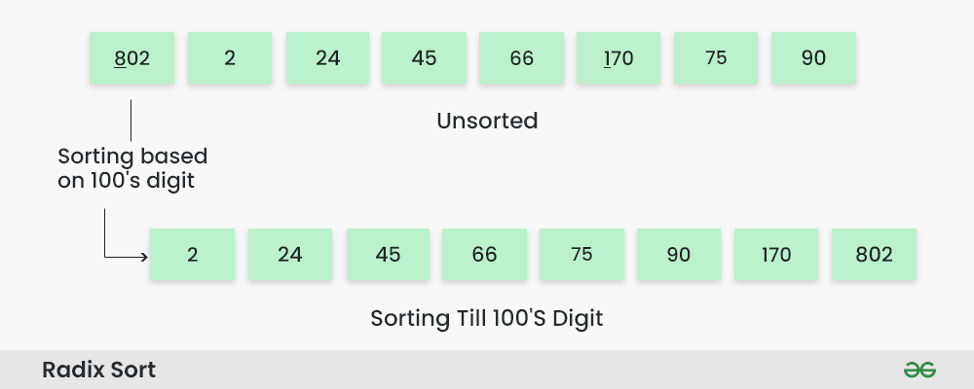
How does Radix Sort Algorithm work?
Step 4: Sorting based on the hundreds place:
Perform counting sort on the array based on the hundreds place digits.
The sorted array based on the hundreds place is [2, 24, 45, 66, 75, 90, 170, 802].

Slide 48
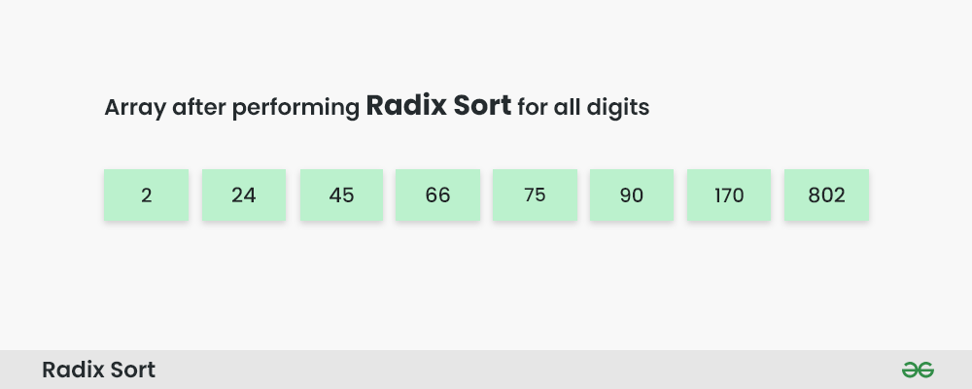
How does Radix Sort Algorithm work?
Step 5: The array is now sorted in ascending order.
The final sorted array using radix sort is [2, 24, 45, 66, 75, 90, 170, 802].

Slide 49
Complexity of Radix Sort Algorithm
It has a time complexity of O(d * (n + b)), where d is the number of digits, n is the number of elements, and b is the base of the number system being used.
Radix sort also has a space complexity of O(n + b), where n is the number of elements and b is the base of the number system.

Slide 50
Sorting Algorithms
Bucket Sort

Slide 51
Bucket Sort Algorithm
Bucket Sort divides the unsorted array elements into several groups called buckets. Each bucket is then sorted by using any of the suitable sorting algorithms.
Finally, the sorted buckets are combined to form a final sorted array.
Scatter Gather Approach
Here, elements are first scattered into buckets
then the elements in each bucket are sorted.
Finally, the elements are gathered in order.

Slide 52
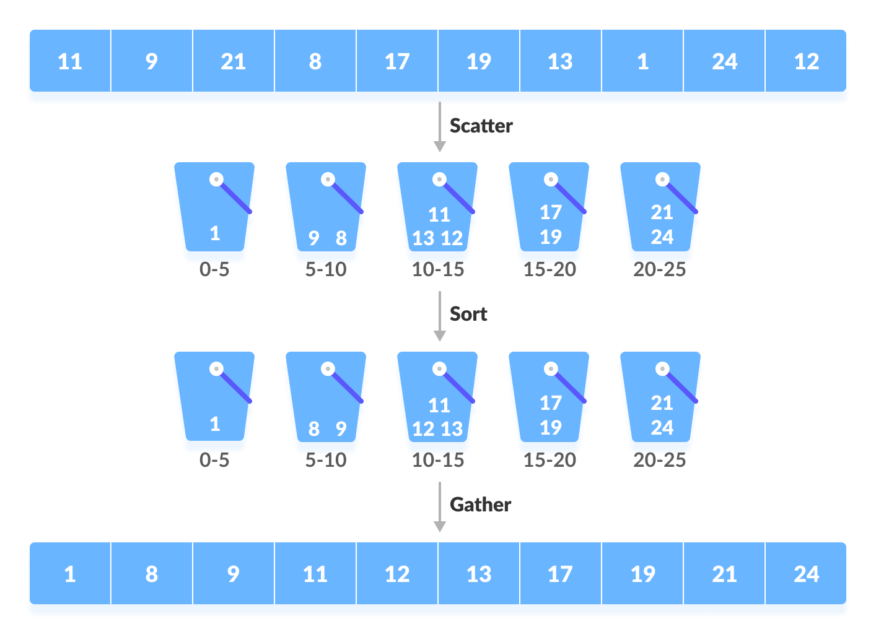
Bucket Sort Algorithm

Slide 53
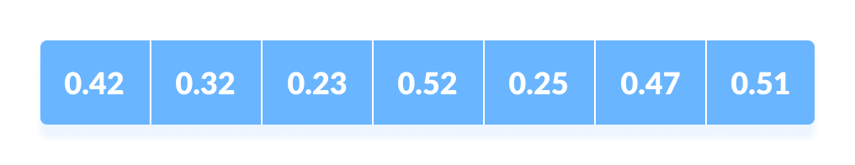
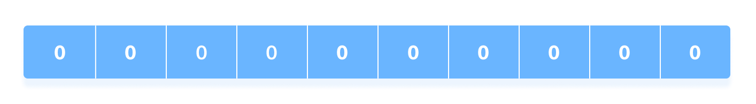
Working of Bucket Sort
Suppose, the input array is:
Input array
Create an array of size 10. Each slot of this array is used as a bucket for storing elements.
Array in which each position is a bucket

Slide 54
Working of Bucket Sort
Insert elements into the buckets from the array. The elements are inserted according to the range of the bucket.
In our example code, we have buckets each of ranges from 0 to 1, 1 to 2, 2 to 3,...... (n-1) to n.
Suppose, an input element is .23 is taken. It is multiplied by size = 10 (ie. .23*10=2.3). Then, it is converted into an integer (ie. 2.3≈2). Finally, .23 is inserted into bucket-2.

Slide 55
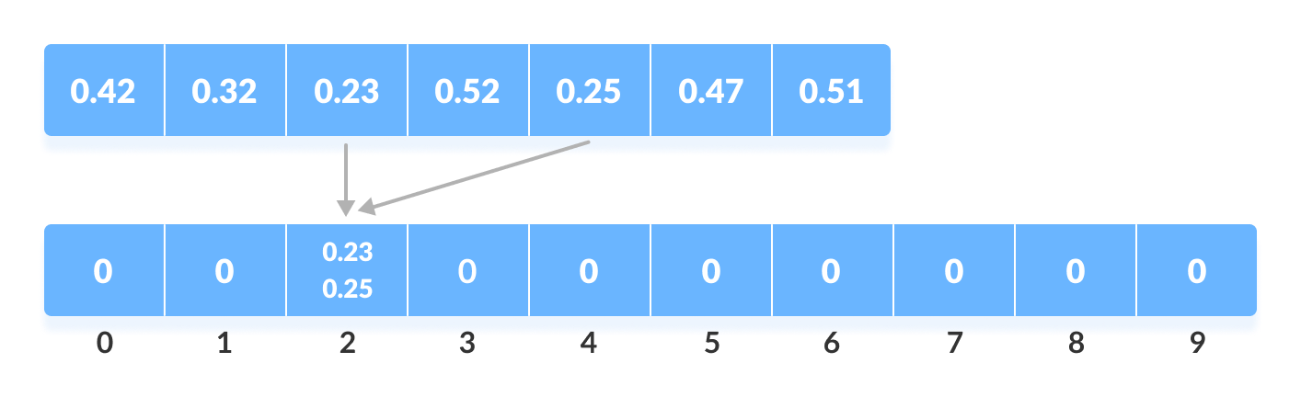
Working of Bucket Sort
Similarly, .25 is also inserted into the same bucket. Everytime, the floor value of the floating point number is taken.

Slide 56
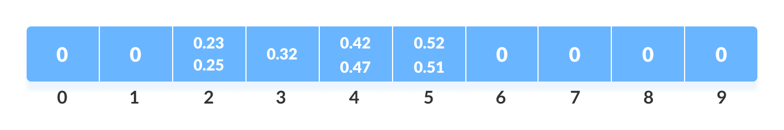
Working of Bucket Sort
If we take integer numbers as input, we have to divide it by the interval (10 here) to get the floor value. Similarly, other elements are inserted into their respective buckets.
Insert all the elements into the buckets from the array

Slide 57
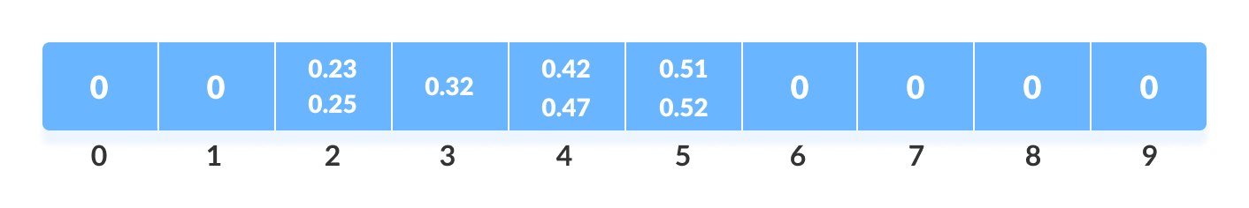
Working of Bucket Sort
The elements of each bucket are sorted using any of the stable sorting algorithms. Here, we have used quicksort (inbuilt function).
Sort the elements in each bucket

Slide 58
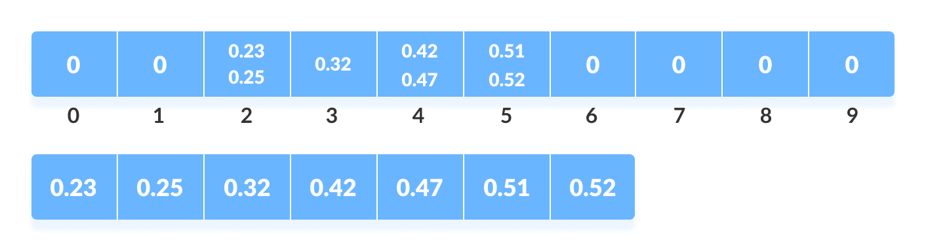
Working of Bucket Sort
The elements from each bucket are gathered.
It is done by iterating through the bucket and inserting an individual element into the original array in each cycle. The element from the bucket is erased once it is copied into the original array.
Gather elements from each bucket

Slide 59
Bucket Sort Complexity
Time Complexity
Best O(n+k)
Worst O(n²)
Average O(n)
Space Complexity O(n+k)

